Slide 1

Inbound Exchange Students
Jenny McKeever, International Officer
Unit for International Mobility

Slide 2
Inbound Exchange Studies
Basis for inbound exchange studies:
Student Exchange Agreement
Course offering in English and willingness of individual departments to accommodate students

Slide 3
Partner University Communication
Agreeing on quota prior to each Annual Year or/and semester
(full year or semester places?)
Nomination Process & Fact Sheet
(students selected by partner for exchange studies)
Receiving Nominations

Slide 4
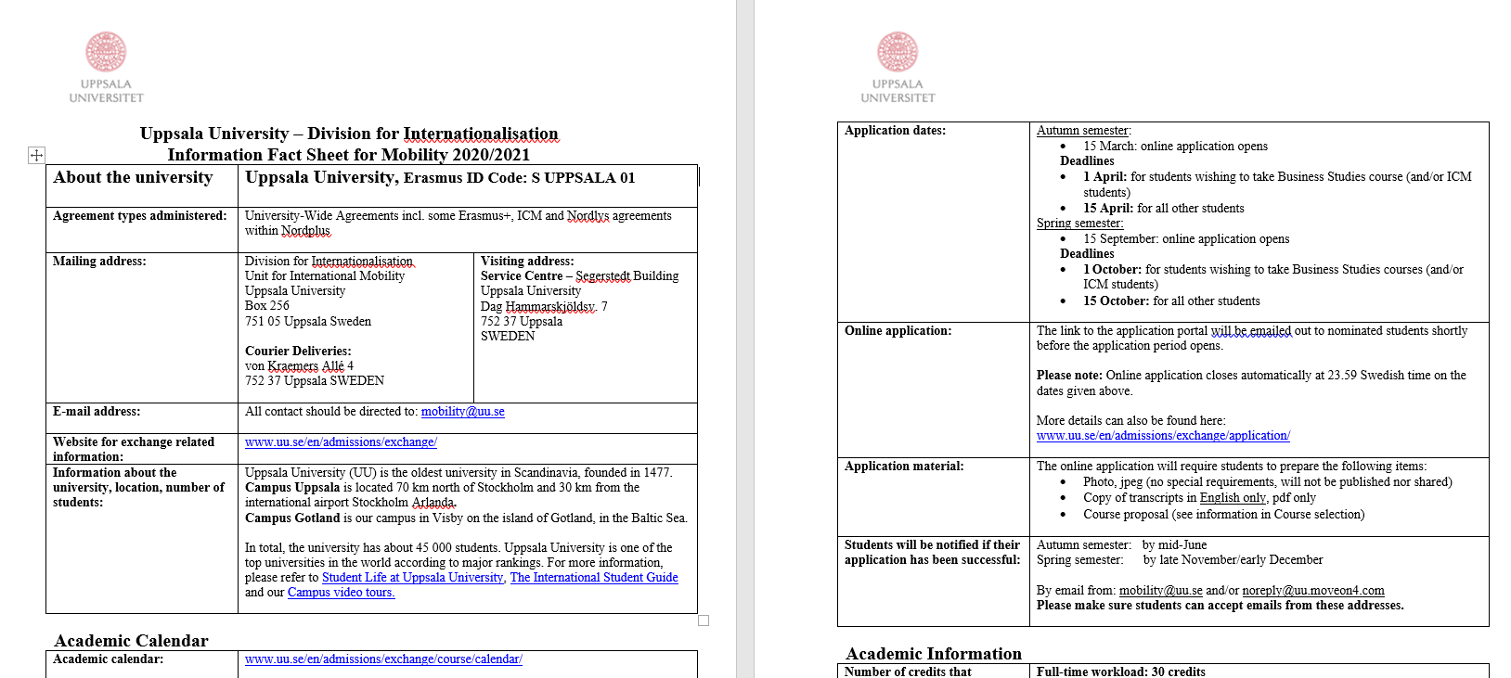
Fact Sheet

Slide 5
Student Communication
Application Information
Course Information
Accommodation
Insurance
Certificate of Acceptance
(required for Swedish Residence Permit application)
Letter of Admissions with Course Confirmation

Slide 6
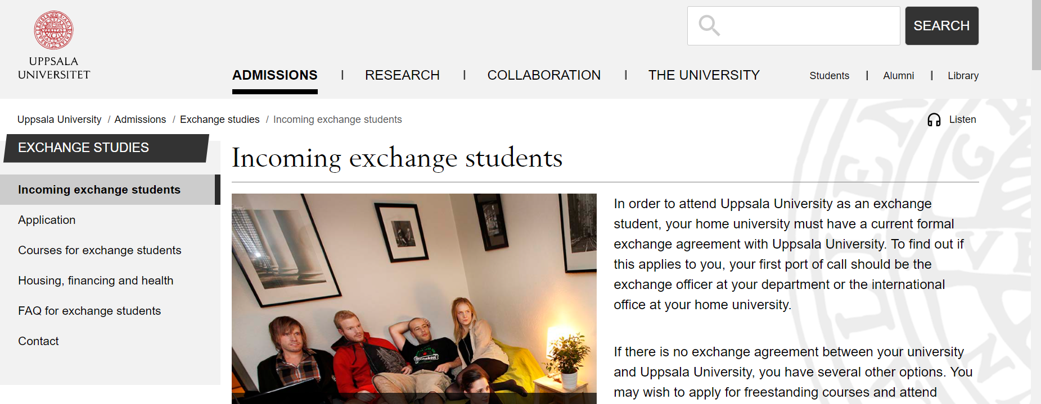
Application Process
We support the students throughout
the applicants process.

Slide 7
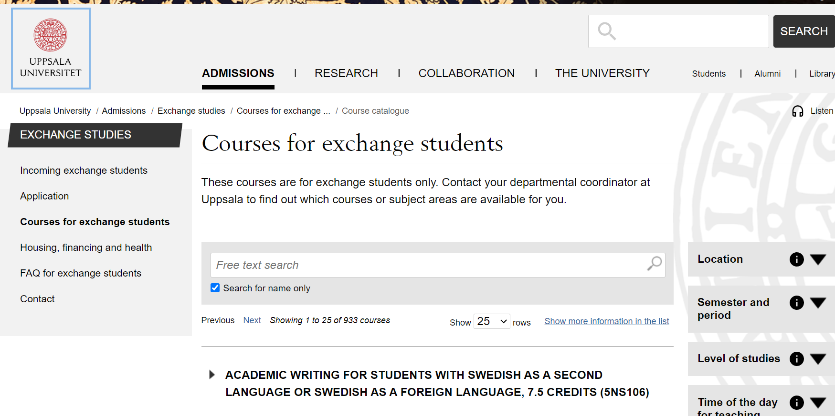
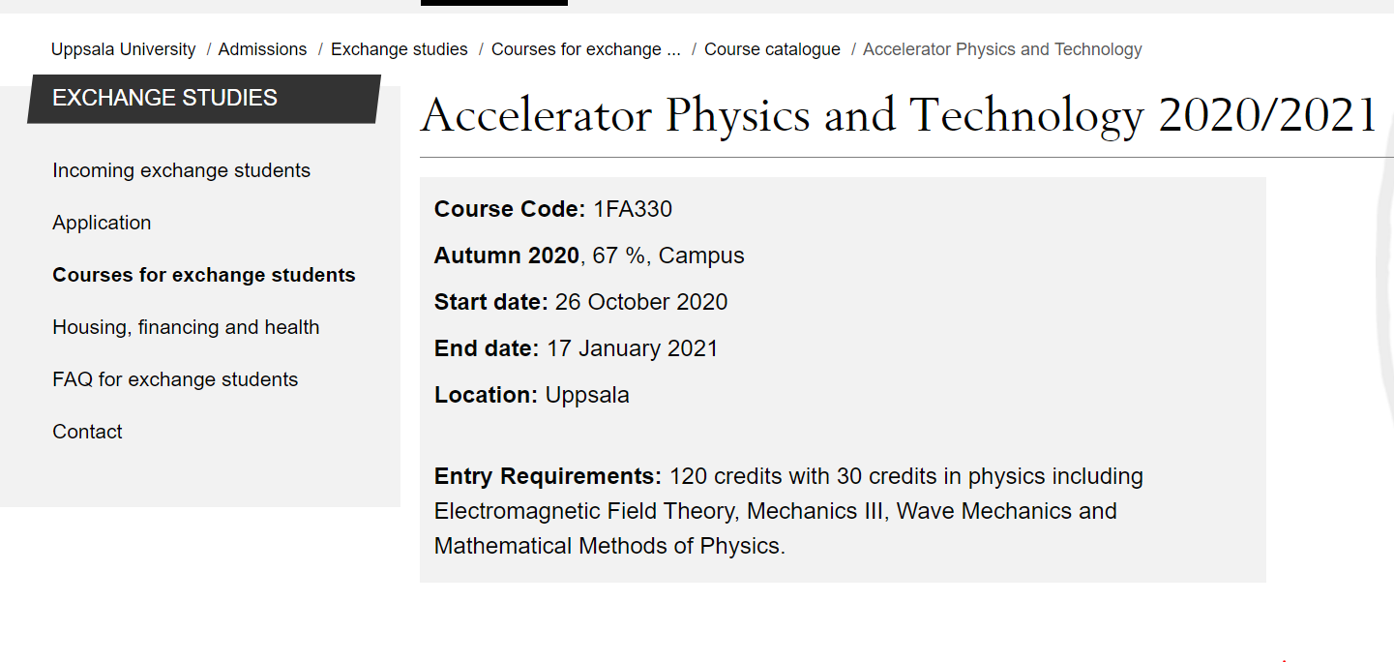
Processing Courses
Entry
requirements
Assessing eligibility
Notes:
Uppsala University is the oldest Nordic university – founded in 1477. It ranks among the best universities in Northern Europe and top 100 in the world.
Archbishop Jakob Ulvsson was the initator behind its establishment. In the beginning, education consisted primarily of lectures in philosophy, law and theology; there was no teaching in natural sciences or engineering.
The university rose to significance during the rise of Sweden as a great power at the end of the 16th century. Uppsala also has an important historical place in Swedish national culture, identity and for the Swedish establishment: in historiography, literature, politics, and music. Many aspects of Swedish academic culture in general, such as the white student cap, originated in Uppsala. It shares some peculiarities, such as the student nation system, with Lund University and the University of Helsinki.
Sen kan man säga något om att det här är sommar/vår för att anspela på nästa bild.

Slide 8
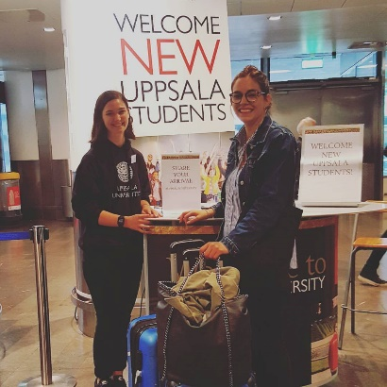
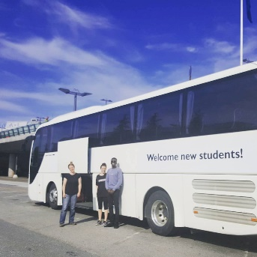

Re-cap - what we offer students
Medical insurance
Housing
Support such as applying for a Swedish Residence Permit
Buddy Programme
After they have arrived:
Welcoming of new students and airport shuttle
Student Health Services
Language Workshop
Digital drop-in for questions
Support

Slide 9
Questions about incoming exchange students?
mobility@uu.se

